Slide 1
Multiple Anesthesias
&
neural systems

Slide 2
01
Part ONE
Anesthesias
α-chloralose
Isoflurane & Medetomidine/dexmedetomidine
Propofol
Urethane

Slide 3
α-chloralose:
Minimal impact on neuro-metabolic coupling
Potentiate GABAergic transmission
Allows measurement of FC with strong strength and good localization
Caudate putamen
Dosage-dependent effects
Evoked activation
Interhemispheric coherence
Attenuated at high dose

Slide 4
Isoflurane :
Quick, easy ,safe and
good recovery
Multiple systems
Gutamatergic system
GABAergic systems
Strong vasodilatory effect
Neurovascular coupling
Dosage-dependent
High dose :
reduced or complete loss of bilateral FC
Mid-to-high dose :
burst-suppression activity
Low dose :
strong focal connectivity
thalamocortical connectivity

Slide 5
Medetomidine/dexmedetomidine :
Agonizes the α2- adrenergic receptor
Cause bradycardia and act as vasoconstrictors
Less impact on neural activity and neurovascular coupling
Easily reversible by an antagonist
Low dose: strong and focal RSNs
High α2 receptor density:
Connectivity reduces dosage- and duration-dependently
Low receptor density: unaffected
Unlike : α-chloralose &isoflurane
Increasing the dosage :
no neurovascularcoupling
No evoked activation
No fluctuation amplitude
Reduces the synchrony
Notes:
Dexmedetomidine is the active enantiomer of medetomidine and has twice the potency; consequently, the dosage is typically half that of medetomidine. HIGH:thalamus LOW:caudate putamen

Slide 6
Medetomidine + isoflurane :
Medetomidine : epileptic activity after long periods of sedation
Combining medetomidine with a very low dose of isoflurane
Detecting strong bilateral FC, the DMN and even anti-correlation
Suppressing the potential epileptic effects without altering the evoked potential

Slide 7

Front. Neural Circuits
Bukhari , 2017
Isoflurane
Medetomidine
Combined
ICA analysis
Dual Regression
Network modeling
C57bl/6 mice
RsfMRI
FSL

Slide 8
ICA Analysis
Concat-ICA :Multisession temporal ICA concatenated approach
IC maps :for each analysis group (70 independent components)
Threshold : based on fitting a Gaussian/gamma mixture model ,

Slide 9
ICA Analysis
Exclude :
overlapped with vascular structures and ventricles
regressors of no interest in the DR analysis
prone to be affected by motion-related artifacts
17 independent components remained at last

Slide 10
Dual Regression(DR)
Between-subject analysis
Unpaired t-tests among different groups
Matrix : subject to [1 -1] contrasts
Notes:
To identify brain regions and networks displaying greater FC in one anesthetic condition relative to another.

Slide 11
Dual Regression(DR)
Non-parametric permutation based inference analysis
performed with subject-specific component spatial maps concatenated across subjects
5000 randomized permutations :for each analysis
Notes:
Then submitted to voxel-wise between-subject analysis testing for effects of anesthetics on FC using FSL-randomize

Slide 12
Dual Regression(DR)
TFCE: threshold-free cluster enhancement
Correction for multiple comparisons
Bonferroni correction
Notes:
These clusters were then used as input in to the GLM analysis and run through FSLrandomize (Winkler et al., 2014) to perform 5000 permutations to test for statistical significance.

Slide 13
Network Modeling
Different network matrix calculation methods:
FC: Full correlation (direct and indirect connections )
PC : Partial Correlation (direct connections,this one )
Notes:
BOLD time courses

Slide 14
Propofol :
A GABA receptor agonist
Not attenuating BOLD activation even at high dose
well-preserved neurovascular coupling
minimal vascular effects
Dosage-dependent changes in RSNs
Be used to induce hypnotic sedation through to deep anesthesia for surgery as the dosage increases
For studying the loss of consciousness

Slide 15
Propofol :
With increased dose:
cortical connectivity in the motor cortex and DMN decreases
thalamic and hypothalamic connectivity remains stable
in some subcortical areas, connectivity is reduced but rebounds at a higher dose
Similar to isoflurane and α-chloralose : ,the thalamic connectivity is weak even at very low doses
Greater anti-correlation
Notes:
some subcortical areas: hippocampus and caudate putamen

Slide 16
Urethane:
Multiple neurotransmitter systems
GABA receptors
N-methyl-D-aspartate (NMDA) receptors
Minimal impact on systemic hemodynamics and the cardiovascular system
Dosage-dependent depression of bilateral connectivity and loss of spatial specificity
Induce sleep-like states
Rapid eye movement (fast wave)
Non-rapid eye movement (slow wave)
Investigate RSN dynamics in sleep
Notes:
vascular effect with broad and slow hemodynamic oscillation

Slide 17
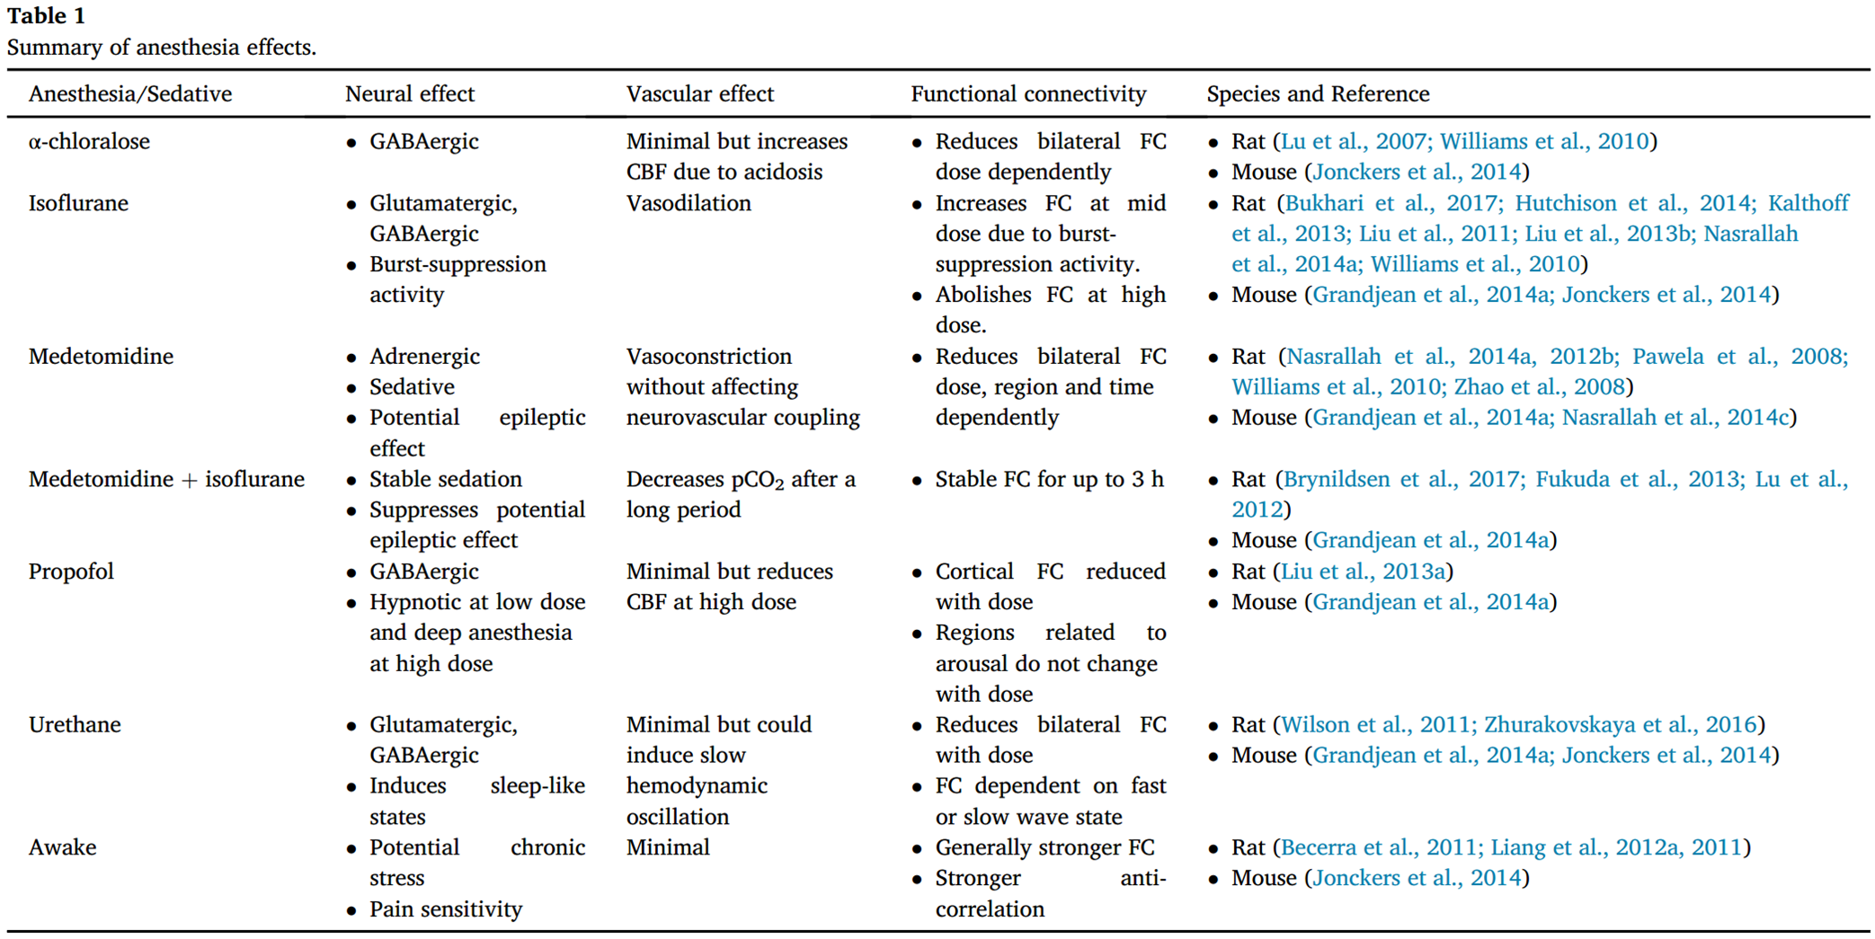

Slide 18
02
Part TWO
Neural systems
Identify brain regions scopolamine induce intensity changes
Evaluate the effects of scopolamine on FC
Whether scopolamine-induced memory effect could be
reversed with milameline

Slide 19
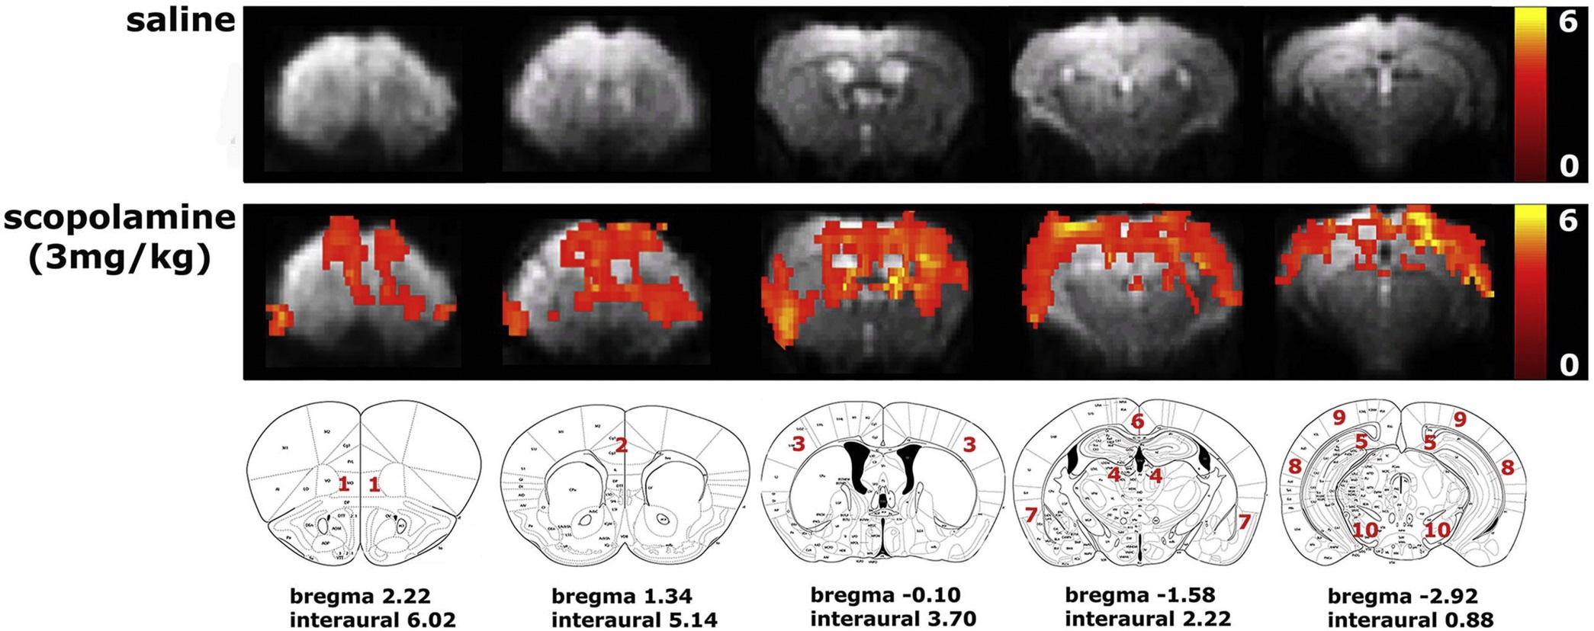
Paired-t test
Between pre&post
Respective to saline &scopolamine
Several cortical regions :
OFC: Orbitofrontal cortex
Cg: Cingulate cortex
SS: Somatosensory cortex
Resp: Retrosplenial cortex
AC: Auditory cortex
VC: Visual cortex
RC: Rhinal cortex
Hippocampus
Color scale: T values

Slide 20
Ph rsfMRI
Part ONE: ROI-based analysis
Cortial regions and hippocampus as ROI
FC between ROIs
Individual correlation matrices by calculating the correlation coefficient between time traces of each pair of ROIs
Mean z-transformed FC matrices per group
-- FDR correction to correct for multiple comparison

Slide 21
Ph rsfMRI
Design 1:
N = 12/group
Baseline : 15 min post-injection
Scopolamine administered
25 min later: Ph rsfMRI
Milameline administered
25 min later: Ph rsfMRI
Design 2:
Three groups:
Saline
Scopolamine
Milameline
N = 8/group

Slide 22
Thank you all for listening~

